Slide 1
Project Week Kick-off
January 6th, 2023

Slide 2
Agenda
Welcome & Introductions
Overview of Best Buy
Introduction to the Problem & Data
Tips & Tricks for presentation day
Effective executive summaries
Storytelling with data
Next Steps
Q&A

Slide 3
About Best Buy

Slide 4


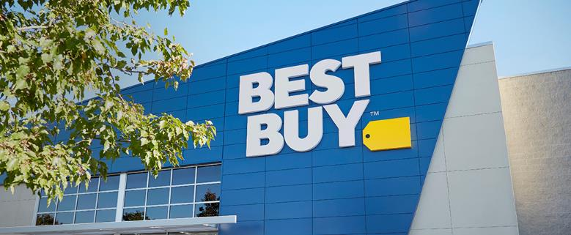

About Best Buy
Enriching lives through technology.
Company overview
Almost $52 billion in
revenue for fiscal 2022
More than 1,000 stores in the U.S. and Canada, including pilot models across the country
Approximately 100,000 total employees
Enterprise comp sales increased 10.4% in FY22 on top of growth of 9.7% in FY21
Since launching in October 2021,
Best Buy Totaltech membership
program has grown to about 5 million
BestBuy.com is one of the top retail websites in the United States

Slide 5

About Best Buy
Enriching lives through technology.
Awards & Recognition
100 Most Sustainable Companies (Barron’s – Top 5 for 4 straight years)
100 Best Workplaces for Innovators (Fast Company)
America’s Best Employers for Women (Forbes)
America’s Best Employers for Diversity (Forbes)
Best Places to Work for LGBTQ+ Equality (Human Rights Campaign)
World’s Most Admired Companies (Fortune)

Slide 6




Data & Analytics Overview
Decision Science
Data Science & Applied Machine Learning
Develops strong cross-functional partnerships
Emphasis on technical expertise
Strategic Decision Support
Analytics Innovation
Data analysis & data discovery
Analytics Discovery
Analytics Applications
Notes:
Decision Science Develops strong cross-functional partnerships
Analytics partnership aligned to our key business functions (Customer Office, Omnichannel) – working directly with our business teams to deliver next-generation digital tools and analytical solutions
Strategic Decision Support – supporting our key enterprise decisions with objectivity, using data as a foundation
Analytics Innovation – educate our business on the “art of the possible” and evangelize analytics solutions
Data analysis & data discovery – What else are we capable of doing/knowing?
Data Science & Applied Machine Learning Emphasis on technical expertise
Analytics Discovery – study feasibility of an idea and exploring data
Analytics Applications – operationalize data products into an end user friendly application

Slide 7
Joining our team!
Roles: Data Scientist, Machine Learning Scientist, Decision Scientist
Locations: Atlanta (Data Science & ML), Minneapolis (All roles)
How: https://jobs.bestbuy.com
When: Full time roles post throughout the year as needed
Meet with us @ the Spring Career Fair on February 10th!

Slide 8
Problem & Data

Slide 9
The problem / opportunity
Business Problem
Accurate sales forecasting is required to support all areas of our business and over the years we’ve built many great models for this from the large amount of data available to us
However… there are items we don’t sell in large quantities but still need to be forecasted
Forecasting is more challenging because the signal for sales can be harder to detect in a smaller data set
There are lots of items that fall into this category, meaning forecasting needs to be efficient – multi-day model runs to forecast sales for 1 week simply won’t work
Project Week Objective
Create a forecast for slow-selling SKUs for one week out that champions both accuracy and speed

Slide 10
Data Sets
Best Buy Provided Data
We’re starting you with a file that contains sales data for 575 of our slow selling SKUs until 7/31/2022
On January 18th we’ll provide a second file in the same format with an additional week's worth of data for you to run validation tests and evaluate your model's true accuracy
External Data Sources
You’re free to use any public data source as an input to your model, such as:
Inflation Data
Household Spending
Consumer Confidence
Demographics
A few we can recommend:
The Federal Reserve's Supply Chain Pressure Index
The University of Michigan's Consumer Sentiment Survey

Slide 11
Factor Descriptions
Here's a breakdown of the factors in the dataset you'll receive:
Encoded_SKU_ID: A unique ID to identify each SKU
SALES_DATE: The date the sales for the record.
SUBCLASS_NAME/CLASS_NM/ML_NAME/VP_NAME/CATEGORY_NAME: Each SKU is organized into a multi-level hierarchy to group it with similar SKUs. This structure goes from the most granular (SUBCLASS_NM) up to the very broad (CATEGORY_NAME). When we don't have enough data to understand trends for a specific SKU, it is often helpful to look at the aggregate trend from other SKUs that fall into the same portions of the hierarchy.
RETAIL PRICE: The "Full Price" we would sell this SKU for. If there's no PROMO_PRICE, this was the price it was on this day.
PROMO_PRICE: The price we put it on sale for (this is blank if there was no promo).
COMPETITOR_PRICE: The price our competitors were at for this SKU on this day, if known.
Inventory: High-level categorization of our inventory level for this SKU on this day.
DAILY UNITS: Your Target variable – how many units of this SKU were sold on this data.

Slide 12
Scoring Criteria
Model Accuracy
Lowest RMSE
Runtime / Accuracy Trade-Off
Runtime & Type of System
Trade-offs between run-time and accuracy
Usage of Exogenous Data
Did it improve accuracy?
Logical to use and publicly accessible?
Model Handoff
Documentation deliverable
Ability to implement – how hard would it be to pick up and keep running with your project?
Team Collaboration
Did everyone have a role?
How was work divided?
Presentation Narrative
Usage of storytelling
Completeness of story & recommendations
Presentation Deliverable Quality
Efficient use of slides
Well-polished materials
Effective visuals
Business Understanding
Demonstrated understanding of business
Recommendations make business sense

Slide 13

Deliverables
Models & Code
Visualizations
Presentation
Transition document (limit to 1 page)
Explain each code file at a high-level
Lay out key facts about the model (e.g. type, what factors used to decide)
Upload by 11:59PM EST on January 19th, 2023 to SharePoint folder

Slide 14
Tips & Tricks

Slide 15
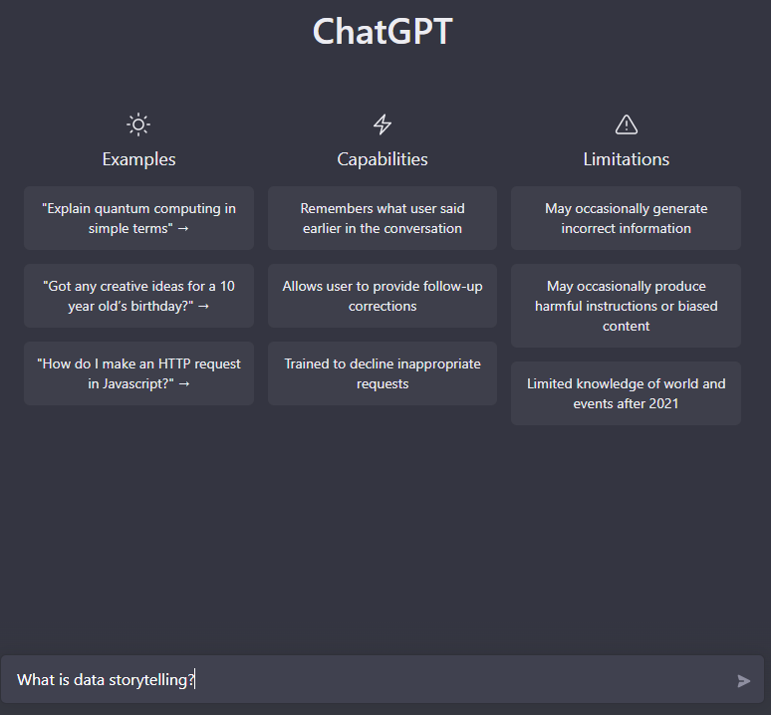
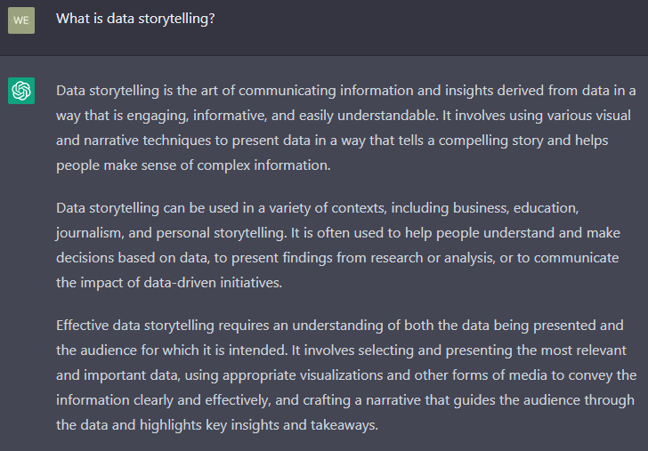
What is Data Storytelling?
Let’s do what any good data scientist would do and ask the AI…

Slide 16
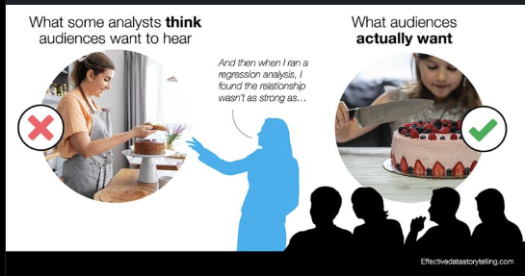
Key Points for Storytelling
Engaging & informative – a compelling story makes it easier to make sense of complex information
Requires understanding of both the data and the audience
Takes the listener through the journey, doesn’t just present a conclusion
Anticipates questions, objections, and actionable next steps
Effective visualizations that get the point across in a direct & succinct manner
Notes:
Know the data… but not just the data! Also think of an audience’s context for that data

Slide 17
A tale of two data stories
Sales are down, so WidgetCo asked their Analytics team to dive into the data and determine what was happening…
Team “Short Story” Presents their findings:
We identified that overall sales are down because we sold less sprockets in March
The sprocket team should do a promotion to boost sales
Team “Storytellers” Presents theirs..
We analyzed sales data across 3 major categories for the last 3 months
As part of this, we noticed an inverse relationship between sprockets and widgets+gears
Partnering with the production team, we came to understand our largest customer orders our parts just-in-time
We recommend a sales-incentive that helps level out each category, providing more predictability & reducing burden on production to ramp-up/ramp-down lines

Slide 18
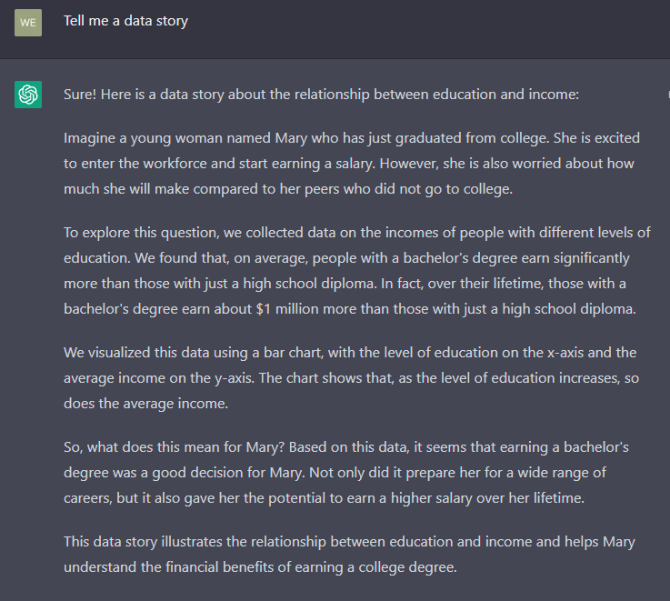
Or we can ask the AI again…

Slide 19
Being a data author
Start with the end in mind, but don’t forget the journey
What do you want the story to convey and what should the audience do after hearing it?
Walk through your story, “I started with this, I then noticed this, so I investigated this..”
Use visualizations appropriate for the message and data
Line chart for trends, bar charts for category comparisons
Use visuals to make a message “pop” and provide support to your narrative
Don’t overwhelm the audience with data, but do use key points
You may need a “Choose your own adventure” version
Craft the story for the audience and what they will care about
Sometimes the audience will want interactivity – amazing insights can come from this type of discovery work

Slide 20
Crafting an “executive summary” presentation
Start with the important facts up front
Why are we here?
What is your key message?
What actions/input do you need from the audience?
Just because it’s a summary doesn’t mean forget good storytelling
This is the “Craft for the audience” piece of storytelling.
Short & concise, but the audience still needs to go on the journey with you
Don’t fall into the trap of “walls of text” to keep to a slide count… instead, make every slide count!
Better to have several slides that each make a point than 1 slide that’s hard to understand

Slide 21
Next Steps

Slide 22
Virtual Office Hours
Drop-in Basis
Opportunity to ask technical or domain knowledge questions
Thursday, January 12th from 11:30AM - 12:30PM
Tuesday, January 17th from 11:30AM - 12:30PM

Slide 23
Speechworks Persuasive Speaker Workshop
Session 1: Friday, January 13th
Session 2: Friday, January 20th
Both Sessions:
8:30AM – 4:30PM
Coda
More details to follow

Slide 24
Deliverables
Deliverables must be submitted to SharePoint folder by 11:59PM on Thursday, January 19th:
Code
Visualizations
Transition Document
PPT Executive Summary slides

Slide 25
Prizes
1st Place: $600 per team member
2nd Place: $400 per team member
3rd Place: $200 per team member
4th Place: $50 Best Buy gift card per team member

Slide 26
Virtual Presentation & Awards Ceremony
Friday, January 20th
Team Presentations (2 tracks) from 9:00AM – 11:30AM
6–7-minute executive summary and 2-3 minutes Q&A
Teams should log-in at least 5 minutes prior to their presentation time slot
Presentation schedule will be shared this afternoon
Awards Ceremony from 12:30PM – 12:45PM

Slide 27
Questions?

Slide 28








Thank you for the time!
Most of our customers seem to be thoughtful go-getters, ambitious, active & social.
Technology excites them!
They buy across categories, channels and price points —
but they need & want help with technology.
28

